Slide 1
Thought
Language
Fundamental Elements
Proxy,Differentiation,Embodiment
Existence
Self
Soul
Organism
Idea
Knowledge
Reaction Vessel

Slide 2
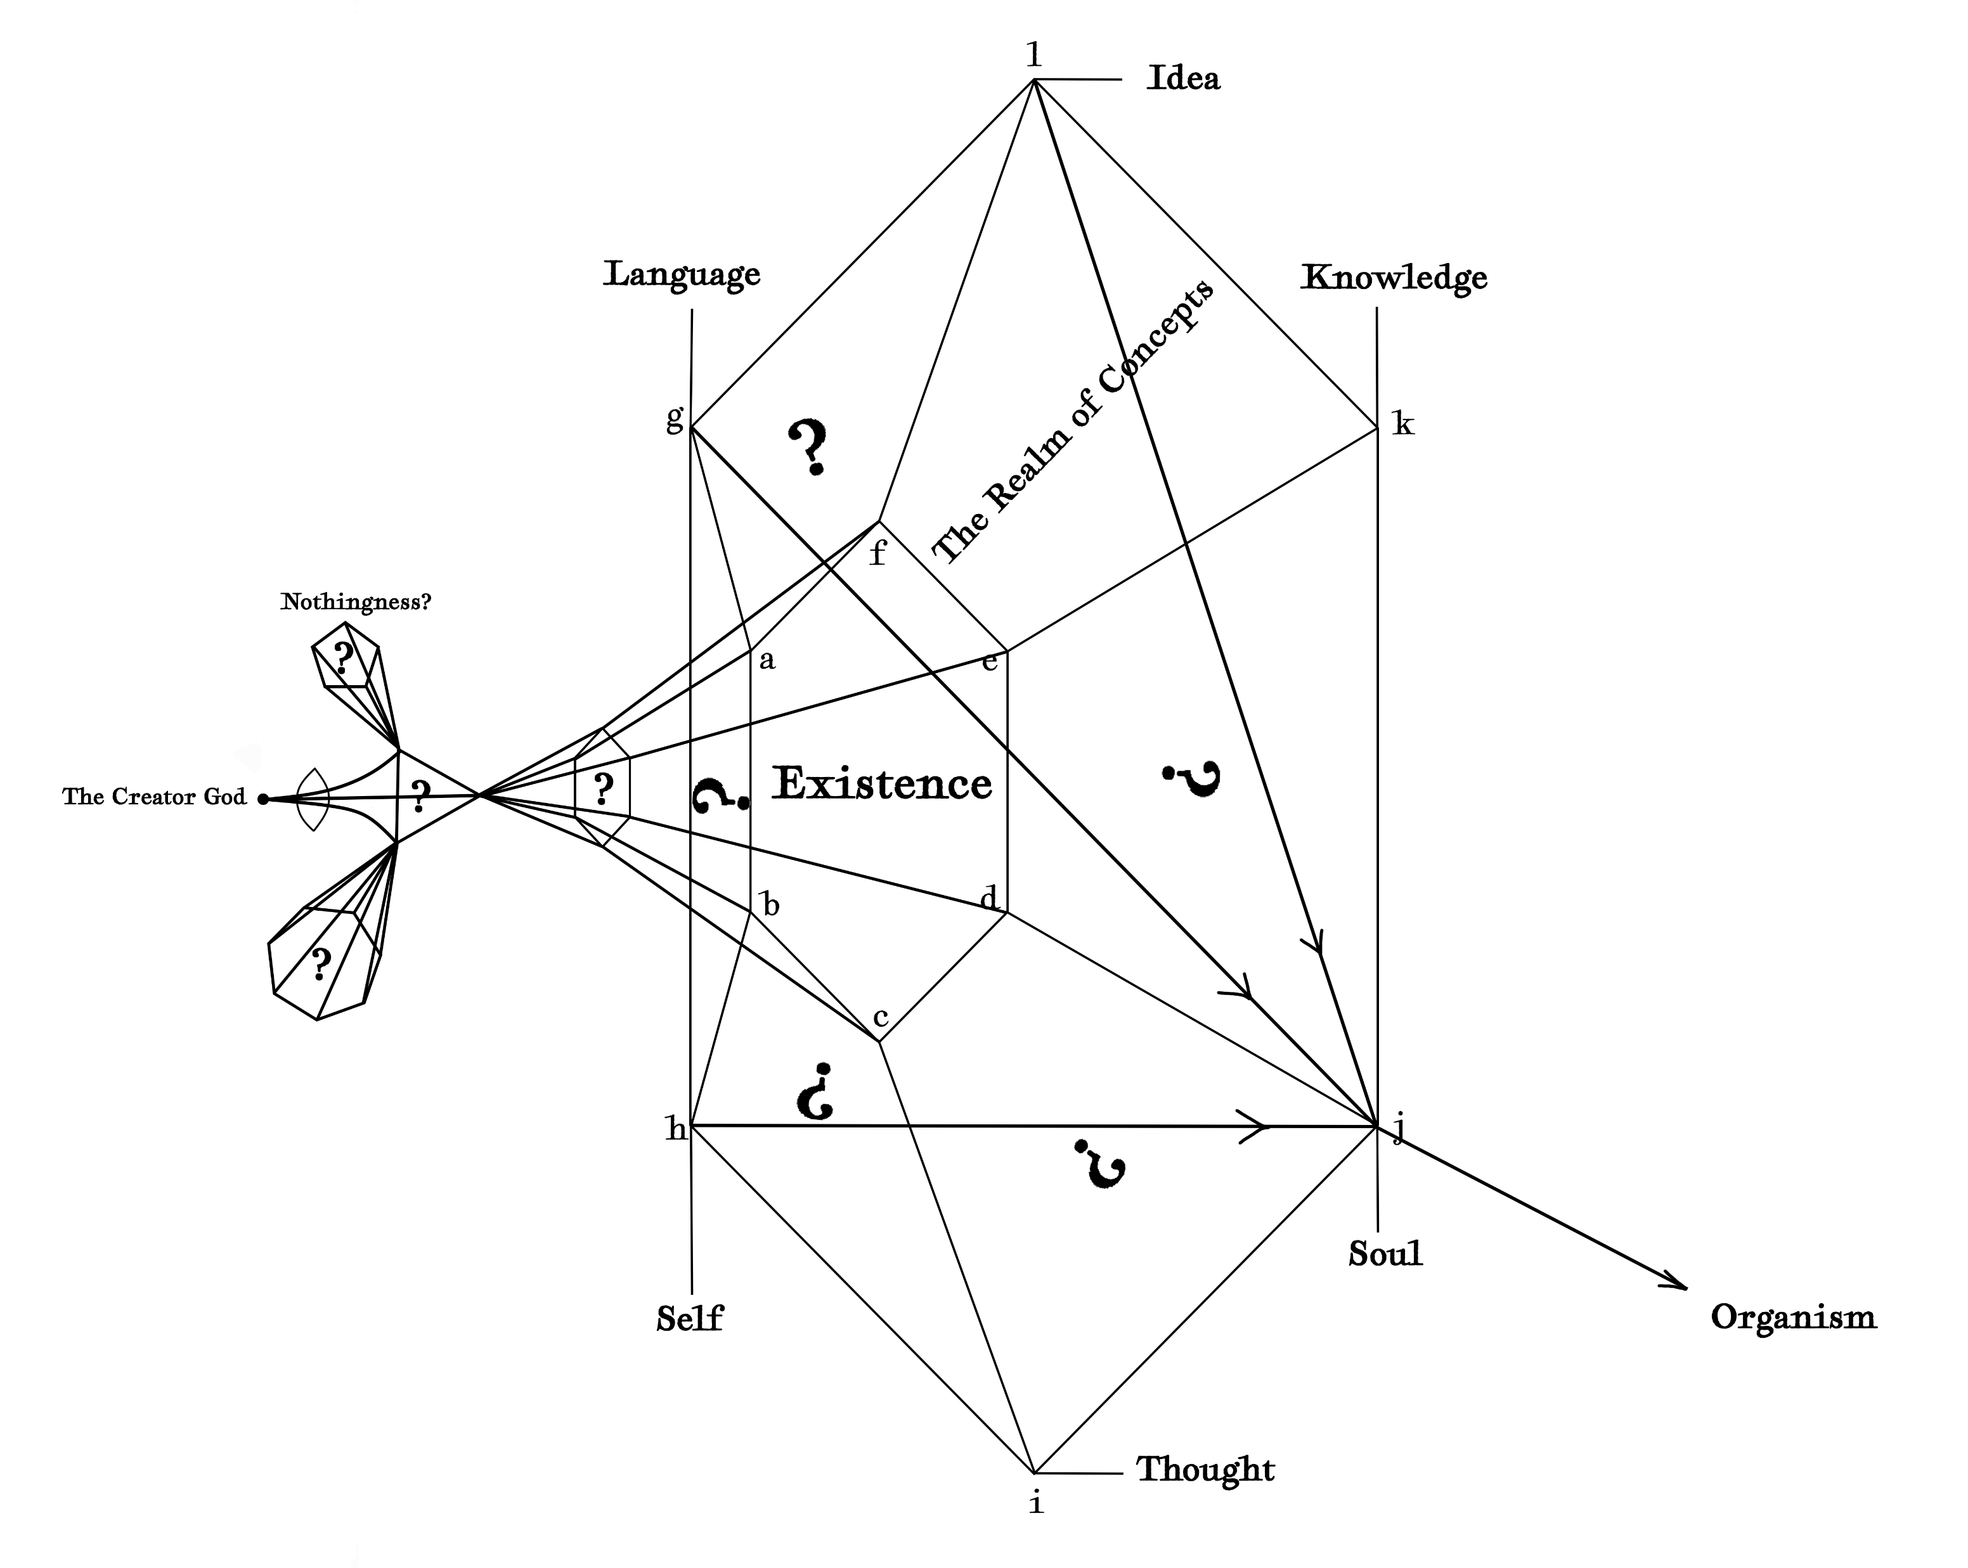

Slide 3
